Slide 1


Weekly Report NTUA 20/3/2020
George Bakas

Slide 2
Status Report
Analysis:
Mass fit
Reduce the ttbar contamination
Simultaneous fit in 0 and 2btag region
Unfolding
Result of the fit has a small deviation regardless the method we are using
Signal Extraction--> Unfolding to parton or particle level and comparison with 2016 paper results
Measured dist from data
QCD shape taken from Data (CR)
$$S\left(x_{reco}\right)=D\left(x_{reco}\right)−N_{QCD, reduced}^{(2)}C_{QCD}^{shape}\left(x_{reco}\right)Q\left(x_{reco}\right)−B(x_{reco})$$
Fiducial Yield
Mass Fit
QCD shape correction factor
Subdominant bkg shape and contribution (MC)

Slide 3
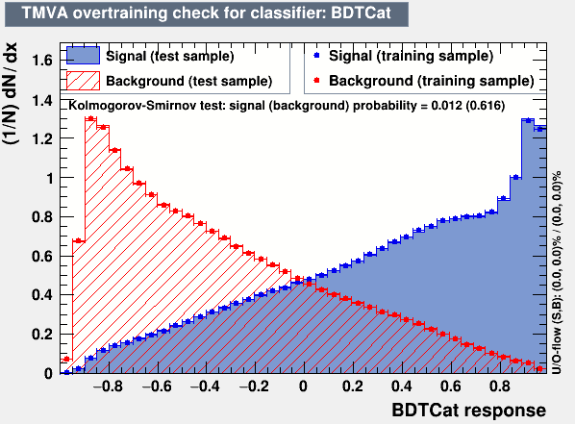
Workaround
For selecting a Control and Signal Region we apply the following:
Signal Region
Basic Selection
Medium b-tagging WP
Top Tagger Cut ( > selected WP)
Control Region
Basic Selection
NOT Loose b-tagging WP
Top Tagger Cut (selected WP)
!! Giannis Suggested applying a harder cut in the Control region to reduce Top Contamination
!! I suggest that we do the same thing we do with b-tagging:
For the CR:
NOT Top Tagger Cut lower than working point that is bkg dominated. For example we could take -0.6 up to -0.3
CR Selection
SR Selection

